Slide 1

Modern Data Transformations
Data Build tool

Slide 2
What is DBT?
dbt is a development framework that combines modular SQL with software engineering best practices to make data transformation reliable, fast, and fun.
The tool is mostly used by data analysts and engineers to work with data, by providing a consistent and standardized approach to data transformation and analysis.

Slide 3
How is DBT used?
DBT is an open-source ETL tool that lets data analysts and engineers easily and effectively transform data into tables and views with their SQL commands.
DBT is mostly used to perform “T” in ETL(Transformation).
DBT to connects to various Datawarehouse(Bigquery, Snowflake, Redshift etc..)

Slide 4
DBT CORE
dbt Core is an open-source tool that enables data teams to transform data using analytics engineering best practices. You can install and use dbt Core on the command line.
We can use “pip install dbt-core” with python.
Note: dbt-core is compatible with python versions > 3.7 Depending on the type of db we can use the following:
dbt-snowflake\ dbt-postgres \ dbt-bigquery

Slide 5
DBT CLOUD
dbt Cloud is the fastest and most reliable way to deploy dbt. Develop, test, schedule, and investigate data models all in one web-based UI.
It comes equipped with support for scheduling jobs, CI/CD, serving documentation, and monitoring & alerting.

Slide 6
DBT Folder structure
macros: blocks of code that you can be reused multiple times.
analysis: organize analytical SQL queries in your project - these won't be executed
images: lineage graph of the project(data transformations from various sources/models
models: contains SQL queries for transforming, analysing the data
seeds: CSV files with static data that you can load into your data platform with dbt.
tests: SQL queries to test the models or business requirements
docs: documents of the project.
dbt_project.yml:
All the configuration(paths to various folders) are set in this file.

Slide 7
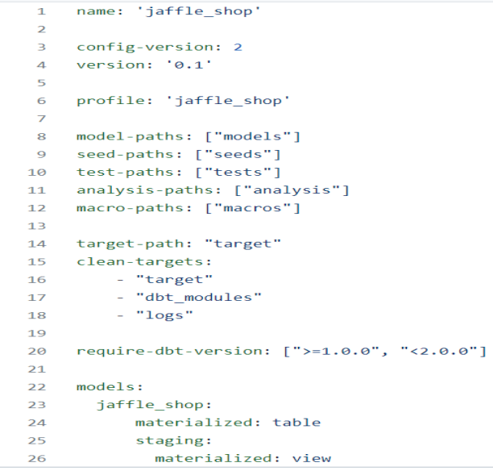
Dbt_project.yml
Every dbt_project needs the
dbt_project.yml file. It also contains
important information that tells dbt
how to operate on your project.
Link: https://docs.getdbt.com/reference/dbt_project.yml

Slide 8
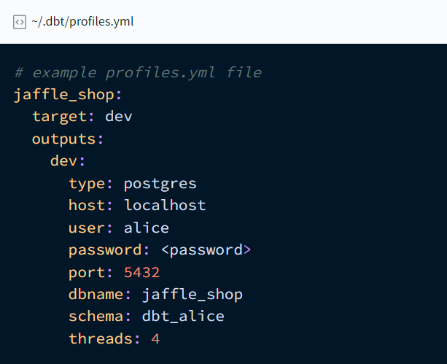
Profiles.yml
This files contains credentials to establish connection to the Datawarehouse.
When you run dbt Core from the command line, it reads your dbt_project.yml file to find the profile name, and then looks for a profile with the same name in your profiles.yml file. This profile contains all the information dbt needs to connect to your data platform. Link for Snowflake: https://docs.getdbt.com/docs/core/connect-data-platform/snowflake-setup

Slide 9
Create a Snowflake account
Signup/Register using personal email.
Snowflake Trial : 30 days, $400.
Select the region you want to connect
Create a database as DBT_PROJECT
Create PROD and DEV Schemas
We would be adding these details in the profiles.yml to establish a connection between snowflake and dbt

Slide 10
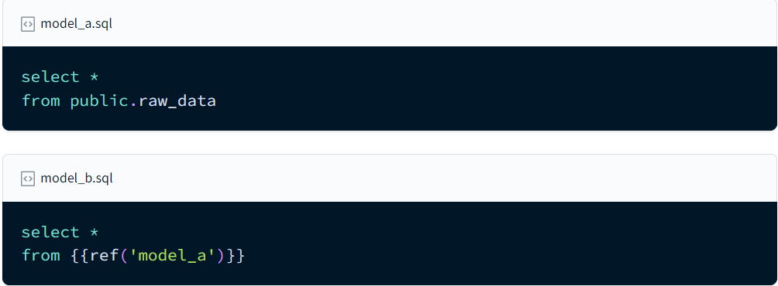
DBT Models
Contains SQL queries for transforming, analysing the data
Model folder is where we write our transformation logic to create views, tables in the database
Using ref in models

Slide 11
Modularity
We could build each of our final models in a single model as we did with dim_customers, however with dbt we can create our final data products using modularity.
Modularity is the degree to which a system's components may be separated and recombined, often with the benefit of flexibility and variety in use.
This allows us to build data artifacts in logical steps.
For example, we can stage the raw customers and orders data to shape it into what we want it to look like. Then we can build a model that references both of these to build the final dim_customers model.
Thinking modularly is how software engineers build applications. Models can be leveraged to apply this modular thinking to analytics engineering.

Slide 12
Sources.yml
version: 2 sources: - name: jaffle_shop database: raw schema: jaffle_shop tables: - name: customers - name: orders
Note: Tests can be added for the sources also. So that we can know if there is any error in source data we got.

Slide 13
Custom Schema’s
All the schema’s would be built in the target we specify in the profiles.yml. In projects with lots of models/tables we can build them in separate schema’s in same database.
You can use custom schemas in dbt to build models in a schema other than your target schema.
dbt will generate the schema name for a model by concatenating the custom schema to the target schema, as in: <target_schema>_<custom_schema>;
Ex: Target_schema: Dev
Custom_schema: Staging
So DBT run would build Dev_Staging
{{ config(schema=‘staging') }}

Slide 14
DBT Tests:
Schema in dbt
Schema defines the columns and their description
DBT has 4 default tests that can be given to any of the models. They are
1) not_null
2) Unique
3) accepted_values
4) relationships

Slide 15
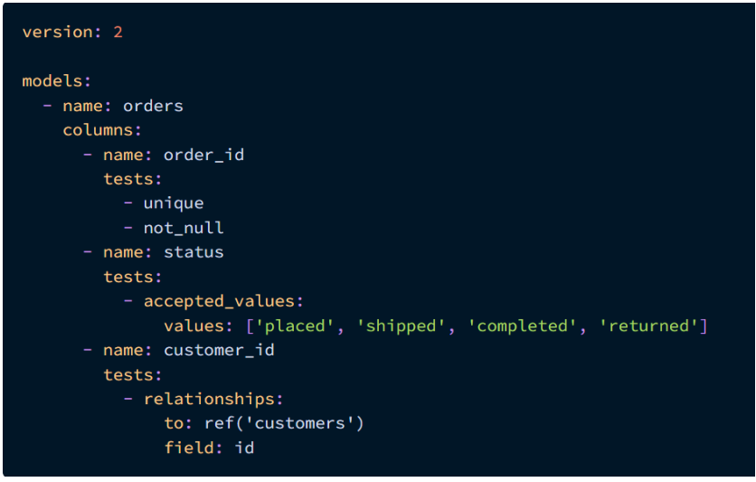

Slide 16
Singular tests
Singular tests: These tests are written in sql query format and this test would be written in such a way that it returns failing records.
Example: we want to test that our ouput should only return positive values.
Select column_name(price) from model(table_name) where price < 0
In the above query we have given price is less than 0 that is exact opposite to what we are testing- our test is to check for positive values. In dbt we must give failing statement in order for our test to work.

Slide 17
Generic tests
Generic tests are defined in such a way that they can be reused repeatedly for various models.
Example:
{% test not_null(model, column_name) %} select * from {{ model }} where {{ column_name }} is null {% endtest %}
The above is a not_null check that is called in the schema file. The schema file passes the model’s name and column name. Link: https://docs.getdbt.com/docs/build/tests

Slide 18
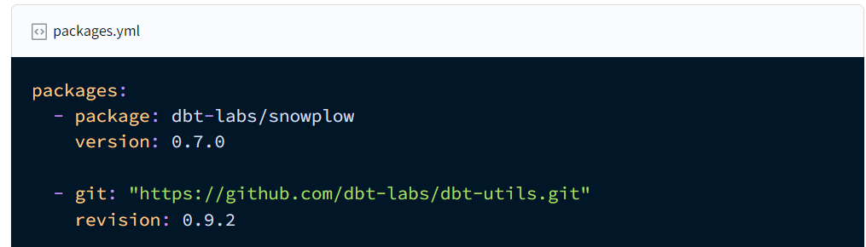
Packages
What is a package?​
Software engineers frequently modularize code into libraries. These libraries help programmers operate with leverage: they can spend more time focusing on their unique business logic, and less time implementing code that someone else has already spent the time perfecting.

Slide 19
Packages.yml
Packages.yml
Install using dbt deps
https://hub.getdbt.com/
Ex:
packages:
- package: dbt-labs/dbt_utils
version: 1.1.0
- git: "https://github.com/EqualExperts/dbt-unit-testing"
revision: v0.2.6
- package: calogica/dbt_expectations
version: [">=0.8.0", "<0.9.0"]
- package: dbt-labs/codegen
version: 0.9.0

Slide 20
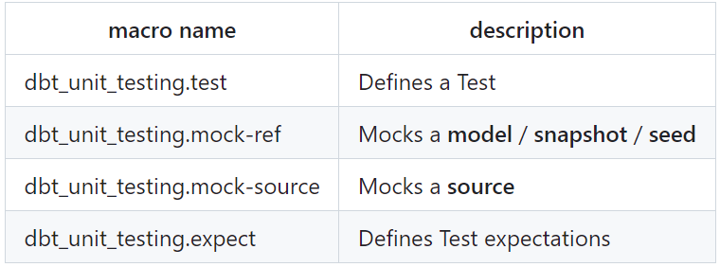
Data quality tests(Mocking data)
Here we use an Equal Experts package that uses mocking data strategy to test our models.
packages:
- package: EqualExperts/dbt_unit_testing
version: 0.3.3
Link: https://github.com/EqualExperts/dbt-unit-testing/tree/master

Slide 21
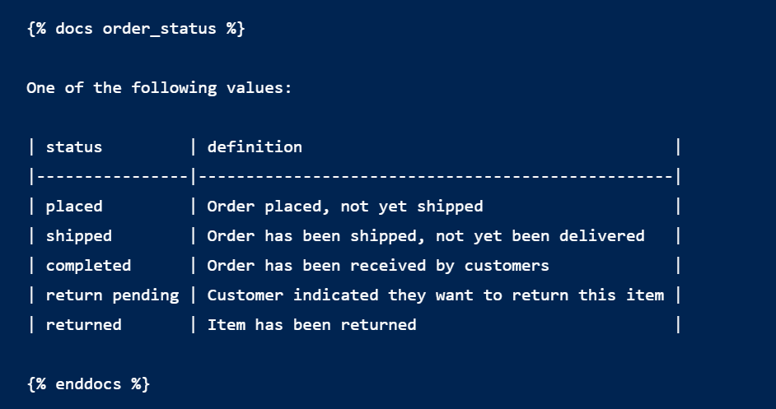
Documentation
dbt docs generate
DBT build runs the model and tests it at the same time.
- name: status description: "{{ doc('order_status') }}“
Md- markdown file
Doc block

Slide 22
Macros
Macros are functions that are written in Jinja. This allows us to write generic logic once, and then reference that logic throughout our project.
Consider the case where we have three models that use the same logic. We could copy paste the logic between those three models. If we want to change that logic, we need to make the change in three different places.
Macros allow us to write that logic once in one place and then reference that logic in those three models. If we want to change the logic, we make that change in the definition of the macro and this is automatically used in those three models.

Slide 23
Jinja
Jinja a templating language written in the python programming language. Jinja is used in dbt to write functional SQL.
{{% .. %}} is used for statements.
{{ ….}} is used for expressions.
{{# .. #} is used for comments
Link to Jinja: Jinja Template Designer Documentation
Jinja Practice: Jinja Live Parser

Slide 24
Github Actions
GitHub Actions is a powerful CI/CD pipeline automation tool for automating software development workflows and is fast becoming one of the go-to choices for pipeline orchestration.
GitHub Actions is tightly integrated with the rest of the GitHub ecosystem, making pipelines easier to use and manage. GitHub Actions allows you to create workflows triggered by various events such as commits, pull requests, and releases. This allows you to automate pipelines that are tightly linked to your development process, thus reducing errors and increasing efficiency.

Slide 25
.github/workflows/
Create a yml file that connects with the github. This is the actions file that setups the workflow. When to run or on what action to run.
Continuous integration (CI) is a software development practice where developers merge their changes to a shared repository multiple times a day.
Regularly merging small code changes is typically a more accurate and safer process.
If any bugs are found in the merging process, they're easier and faster to find.

Slide 26
.yml file
on:[push] env: DBT_PROFILES_DIR: ./ DBT_SNOWFLAKE_ACCOUNT: ${{ secrets.SNOWFLAKE_ACCOUNT }} DBT_SNOWFLAKE_USERNAME: ${{ secrets.SNOWFLAKE_USER }} DBT_SNOWFLAKE_PW: ${{ secrets.SNOWFLAKE_PASSWORD }} DBT_SNOWFLAKE_ROLE: ${{ secrets.SNOWFLAKE_ROLE }} jobs: dbt_run_on_push: name: dbt_run_on_push runs-on: ubuntu-latest steps: - name: Check out uses: actions/checkout@v3 - uses: actions/setup-python@v1 with: python-version: "3.11.x" - name: Install dependencies run: | pip install dbt dbt deps - name: Run dbt models run: dbt run

Slide 27
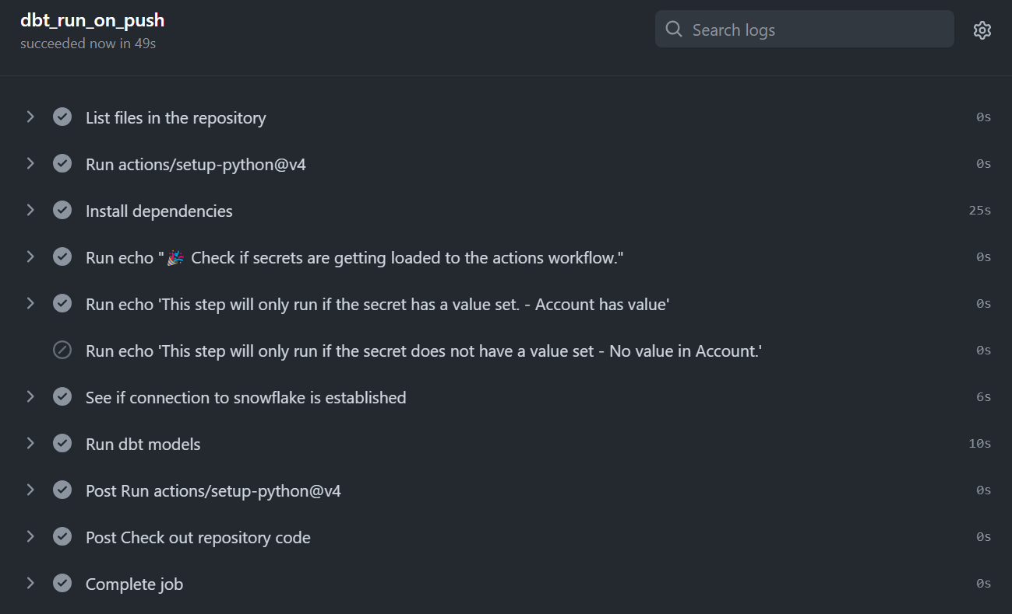
Actions Workflow

